Slide 1

BRITISH AIRLINES
Sentiment Analysis

Slide 2
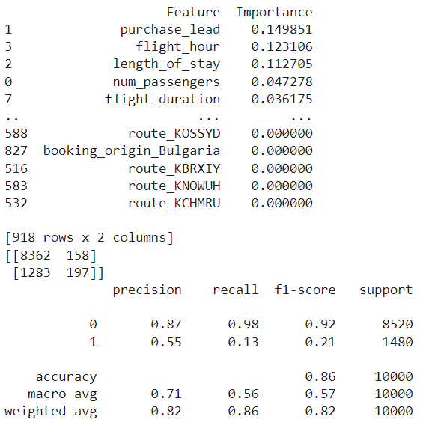
Goal: Build a predictive model to forecast customer bookings.
Algorithm: Use RandomForest or another interpretable model like XGBoost or Logistic Regression.

Slide 3
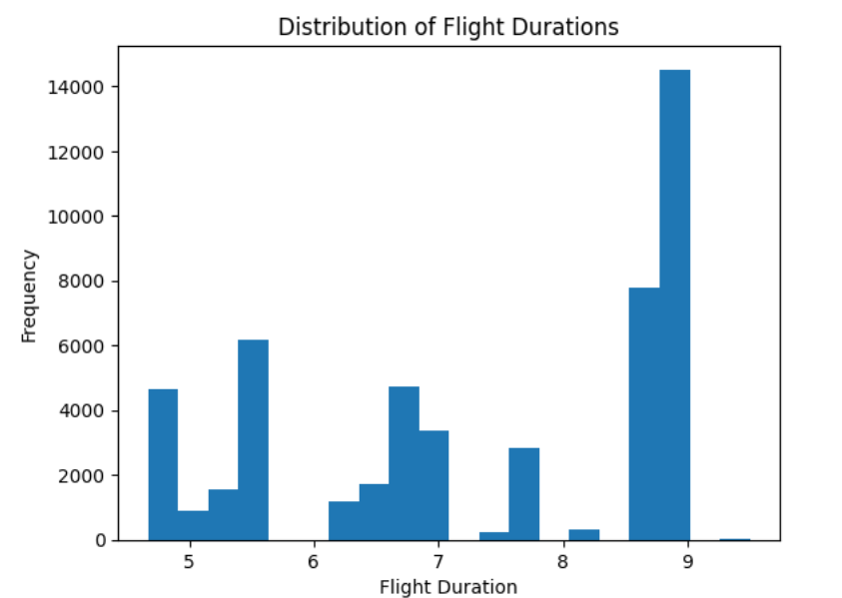
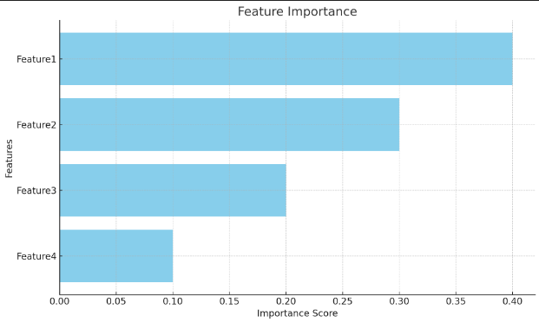
Visualisation

